Slide 1

Car Recommendation System Team Member(s): Zeev Feldbeine, Brenda Izquierdo Product Owner(s): David Villegas Instructor: Masoud Sadjadi School of Computing and Information Sciences Florida International University April 25th, 2016
Senior Project Final Presentation Spring 2016
Notes:
Greet your audience, thank them for attending your presentation, introduce yourself, introduce your project, introduce your team members, and quickly indicate what each of you did in a high-level manner, and put more emphasis on your part/contribution.

Slide 2
Problem definition
Problem 1: Searching for the perfect car is done manually and consumes a lot of time.
Problem 2: Selling a car usually cost money with minimum result
Time consuming
Expensive
Inefficient
Notes:
Introduce the problem that the whole project tackles and stay focused on the parts that you have been working. Indicate if there is an existing previous system, enumerate its problems/limitations, etc.

Slide 3
Problem definition (cont.)
Our Project: Car Recommendation System(CRS) is a social web application that provides services to the users, such as selling and recommending cars based on user behavior.
My Part:
Back-End: Recommendation algorithm, system logic, testing, recording user behavior, Support vector machines, distance algorithm, and priority algorithm
UI/UX - front end, design, and integration
Database Administration: Database scheme, Integrations, and logic with the system

Slide 4
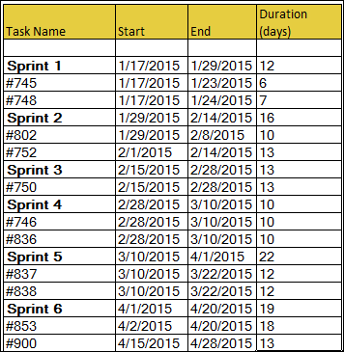
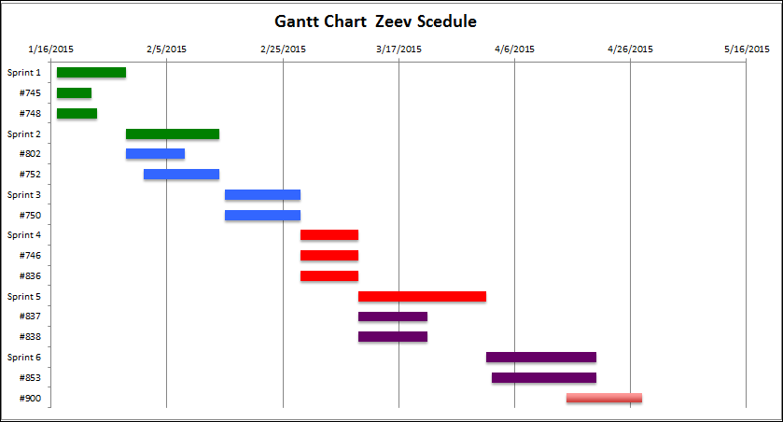
Project Management
Notes:
Project Management (schedule for entire semester) (one slide; Gantt Chart).

Slide 5
Requirements: User Stories
#746: Recommendation(SVM)
#836: Distance Recommendation
#837: List View
#838: google maps
#853: Recommendation(priority)
#745: LogOut, Menu
#748: Login, Registration
#752: Car Display
#802: Car Info
#750: Favorites
Recommendation: As a user I want to be able to search for the perfect car so that I can save money and time
Notes:
4. Requirements:
4.1. User stories implemented (one or more slides).
4.2. UML use cases and the use case diagram for the implemented use cases (one or more slides).
4.3. UML sequence diagrams for the implemented use cases.

Slide 6
Requirements: Use Cases
Notes:
4. Requirements:
4.1. User stories implemented (one or more slides).
4.2. UML use cases and the use case diagram for the implemented use cases (one or more slides).
4.3. UML sequence diagrams for the implemented use cases.

Slide 7
USER STORY #746: USE CASE
Actors: Registered user.
Pre-conditions:
The user has successfully loaded any system web page.
The user has successfully logged into the system.
Description:
Use case begins when user enter to the home page.
The system shall provide the user list of cars based on history of favorites User clicks on the “update” button.
the user shall be able to navigate between the different cars in the
Use case ends when the system do not receive any user inputs
list Post-conditions:
the system continued to present car list and info to the user
the system shall update the list based on user favorites history

Slide 8
USER STORY #746: Sequence Diagram
Notes:
4. Requirements:
4.1. User stories implemented (one or more slides).
4.2. UML use cases and the use case diagram for the implemented use cases (one or more slides).
4.3. UML sequence diagrams for the implemented use cases.

Slide 9
System Design: Architecture
Notes:
5. System design:
5.1. System decomposition; identify the architecture patterns used (one slide).
5.2. System deployment – h/w and s/w requirements (one slide).
5.3. Persistent data design (one slide).
5.4. Security/Privacy (one slide).

Slide 10
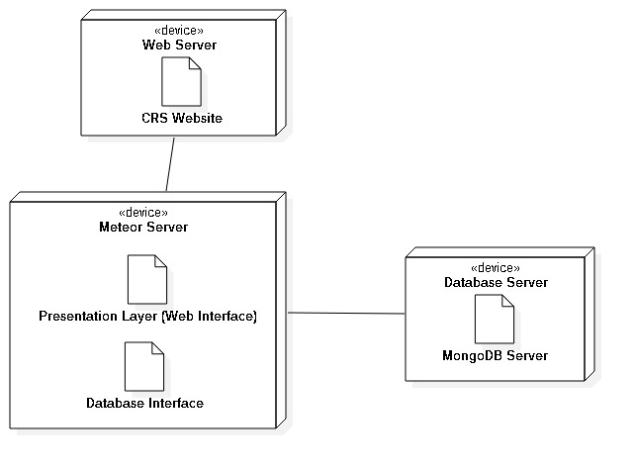
System Design: Deployment
Notes:
5. System design:
5.1. System decomposition; identify the architecture patterns used (one slide).
5.2. System deployment – h/w and s/w requirements (one slide).
5.3. Persistent data design (one slide).
5.4. Security/Privacy (one slide).

Slide 11
Persistent data Design
Notes:
5. System design:
5.1. System decomposition; identify the architecture patterns used (one slide).
5.2. System deployment – h/w and s/w requirements (one slide).
5.3. Persistent data design (one slide).
5.4. Security/Privacy (one slide).

Slide 12
Minimal Class Diagram
Notes:
6. Detailed design:
6.1. Minimal class diagram. Identify the design patterns used (one or more slides).
6.2. State machine for the main control object or the most important object of the implemented uses cases (one or more slides).
6.3. Main algorithm used related to an implemented use case described above (one or more slides).

Slide 13
Main algorithm
Recommendation(){
Pull user favorites history
1.1 if empty return Cars collection 2. Create SVM object 3. Loop through History[]
3.1 hash code the strings and the numbers, valid input
3.1 Convert to valid vector in demission of 20 4. Train Data Set of Vectors History[]. 5. Loop through Car collections
5.1 Predict Vector value, And push it to collection
5.2 calculate the distance between the buyer and the seller
6. Sort based on distance, and than sort based on rank, and than sort by priority
7 . Return collection to the user as a session.
}
Notes:
6. Detailed design:
6.1. Minimal class diagram. Identify the design patterns used (one or more slides).
6.2. State machine for the main control object or the most important object of the implemented uses cases (one or more slides).
6.3. Main algorithm used related to an implemented use case described above (one or more slides).

Slide 14
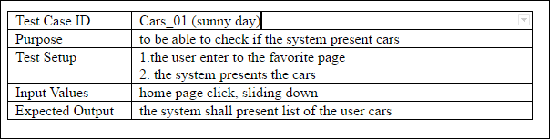
Test Case: Sunny day
Notes:
7. Test Suites and Test Cases (one sunny day and one rainy day) for the use case represented in part (5) above (2 slides).
7.1 One sunny day and one rainy day for the implemented use cases (one or more slides).
7.2 Automated test scripts for the implemented use cases (one or more slides).

Slide 15
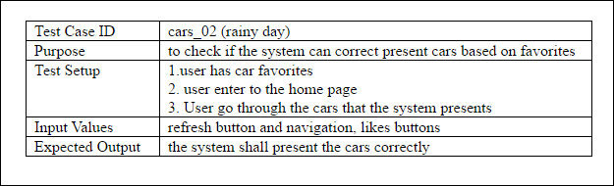
Test Case: rainy day

Slide 16
Summary
My work in the project involves the back-end and the system logic and the database administrations( relationships).
Contact information: zfeld003@fiu.edu
Thank you!
Notes:
Summarize your contribution
Include your contact information
Ask if anyone has any questions for you.
Thank your audience

